Slide 1



Course title : Statistics for Computer Programmers
Code :MATH1236
Session Number : 3
niagaracollegetoronto.ca

Slide 2
MATH1236
Statistics for Computer programming
Lesson week- 3
Harpreet Kaur

Slide 3
AGENDA
Week # | Topic /Theme/Chapter | Assessments and Activities | Learning Objectives
Week 3 | Measures of position and relative standing, empirical Rule Using Excel and R- Studio introduction | Lecture, ppt. and Practice Questions | 2. Apply the empirical rule for a normal distribution 3. Use z-scores and quartiles to identify the position of data in a data set. 4. Use exploratory data analysis to discover various aspects of data.
Harpreet Kaur

Slide 4

Measures of position and relative standing

Slide 5
Percentiles and Quartiles
Harpreet Kaur

Slide 6
Percentiles and Quartiles
A percentile provides information about how the data are
spread over the interval from the smallest value to the largest value.
Admission test scores for colleges and universities are frequently reported
in terms of percentiles.
The pth percentile of a data set is a value such that at least p percent of the items take on this value or less and at least (100 - p) percent of the items take on this value or more.
Harpreet Kaur

Slide 7
Percentiles and Quartiles
Arrange the data in ascending order.
Compute L_{p}, the location of the pth percentile.
L_{p} = (p/100)(n + 1)
Harpreet Kaur

Slide 8
Percentiles and Quartiles
80th Percentile
Example: Apartment Rents
L_{p} = (p/100)(n + 1) = (80/100)(70 + 1) = 56.8
(the 56th value plus 0.8 times the difference between the 57th and 56th values)
80th Percentile = 635 + .8(649 – 635) = 646.2
525
530
530
535
535
535
535
535
540
540
540
540
540
545
545
545
545
545
550
550
550
550
550
550
550
560
560
560
565
565
565
570
570
572
575
575
575
580
580
580
580
585
590
590
590
600
600
600
600
610
610
615
625
625
625
635
649
650
670
670
675
675
680
690
700
700
700
700
715
715
Harpreet Kaur
Note: Data is in ascending order.

Slide 9
Percentiles and Quartiles
80th Percentile
Example: Apartment Rents
“At least 80% of the
items take on a
value of 646.2 or less.”
“At least 20% of the
items take on a
value of 646.2 or more.”
56/70 = .8 or 80%
14/70 = .2 or 20%
525
530
530
535
535
535
535
535
540
540
540
540
540
545
545
545
545
545
550
550
550
550
550
550
550
560
560
560
565
565
565
570
570
572
575
575
575
580
580
580
580
585
590
590
590
600
600
600
600
610
610
615
625
625
625
635
649
650
670
670
675
675
680
690
700
700
700
700
715
715
Harpreet Kaur

Slide 10
Percentiles and Quartiles
Excel’s percentile function is:
=PERCENTILE.EXC(data range, p/100)
Harpreet Kaur

Slide 11
Percentiles and Quartiles
Quartiles
Quartiles are specific percentiles.
First Quartile = 25th Percentile
Second Quartile = 50th Percentile = Median
Third Quartile = 75th Percentile
Excel’s quartile function is:
QUARTILE.EXC (data range, quartile number)
Harpreet Kaur

Slide 12
Percentiles and Quartiles
First Quartile (25th Percentile)
Example: Apartment Rents
L_{p} = (p/100)(n + 1) = (25/100)(70 + 1) = 17.75
(the 17th value plus 0.75 times the difference between the 18th and 17th values)
Third quartile = 545 + 0.75(545 – 545) = 545
525
530
530
535
535
535
535
535
540
540
540
540
540
545
545
545
545
545
550
550
550
550
550
550
550
560
560
560
565
565
565
570
570
572
575
575
575
580
580
580
580
585
590
590
590
600
600
600
600
610
610
615
625
625
625
635
649
650
670
670
675
675
680
690
700
700
700
700
715
715
Note: Data is in ascending order.
Harpreet Kaur

Slide 13
Percentiles and Quartiles
Third Quartile (75th Percentile)
Example: Apartment Rents
L_{p} = (p/100)(n + 1) = (75/100)(70 + 1) = 53.25
(the 53rd value plus 0.25 times the difference between the 54th and 53rd values)
Third quartile = 625 + 0.25(625 – 625) = 625
525
530
530
535
535
535
535
535
540
540
540
540
540
545
545
545
545
545
550
550
550
550
550
550
550
560
560
560
565
565
565
570
570
572
575
575
575
580
580
580
580
585
590
590
590
600
600
600
600
610
610
615
625
625
625
635
649
650
670
670
675
675
680
690
700
700
700
700
715
715
Note: Data is in ascending order.
Harpreet Kaur

Slide 14
Five-number summary and Box Plot
Summary statistics and easy-to-draw graphs can be used to quickly
summarize large quantities of data.
Two tools that accomplish this are five-number summaries
and box plots.
Harpreet Kaur

Slide 15
Five-number summary and Box Plot
Five-Number Summary
1
Smallest Value
2
First Quartile
3
Median
4
Third Quartile
5
Largest Value
Harpreet Kaur

Slide 16
Five-number summary and Box Plot
Example: Apartment Rents
Lowest Value = 525
First Quartile = 545
Median = 575
Third Quartile = 625
Largest Value = 715
525
530
530
535
535
535
535
535
540
540
540
540
540
545
545
545
545
545
550
550
550
550
550
550
550
560
560
560
565
565
565
570
570
572
575
575
575
580
580
580
580
585
590
590
590
600
600
600
600
610
610
615
625
625
625
635
649
650
670
670
675
675
680
690
700
700
700
700
715
715
Harpreet Kaur

Slide 17
Five-number summary and Box Plot
Box Plot
A box plot is a graphical summary of data that is based on a
five-number summary.
A key to the development of a box plot is the computation of the median
and the quartiles Q₁ and Q₃.
Box plots provide another way to identify outliers.
Harpreet Kaur

Slide 18
Five-number summary and Box Plot
Box Plot
Example: Apartment Rents
A box is drawn with its ends located at the first and third quartiles.
A vertical line is drawn in the box at the location of the median (second quartile).
500
525
550
575
600
625
650
675
700
725
Q1 = 545
Q3 = 625
Q2 = 575
Harpreet Kaur

Slide 19
Five-number summary and Box Plot
Box Plot
Limits are located (not drawn) using the interquartile range (IQR).
Data outside these limits are considered outliers.
The locations of each outlier is shown with the symbol * .
continued
Harpreet Kaur

Slide 20
Five-number summary and Box Plot
Box Plot
Example: Apartment Rents
The lower limit is located 1.5(IQR) below Q1.
Lower Limit: Q1 - 1.5(IQR) = 545 - 1.5(80) = 425
The upper limit is located 1.5(IQR) above Q3.
Upper Limit: Q3 + 1.5(IQR) = 625 + 1.5(80) = 745
There are no outliers (values less than 425 or
greater than 745) in the apartment rent data.
Harpreet Kaur

Slide 21
Five-number summary and Box Plot
Box Plot
Example: Apartment Rents
Whiskers (dashed lines) are drawn from the ends of the box to the smallest and largest data values inside the limits.
500
525
550
575
600
625
650
675
700
725
Smallest value
inside limits = 525
Largest value
inside limits = 715

Slide 22
Z-score and Empirical Rule
Harpreet Kaur

Slide 23
Z- score and Empirical Rule
Distribution Shape
https://www.youtube.com/watch?v=U0NZu6f5TMI
z-Scores
Chebyshev’s Theorem
Empirical Rule
Detecting Outliers

Slide 24
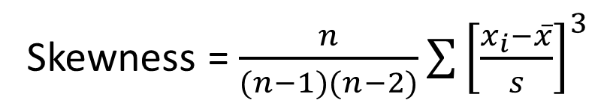
Z- score and Empirical Rule
Distribution Shape: Skewness
An important measure of the shape of a distribution is called skewness.
The formula for the skewness of sample data is
Skewness = $\frac{n}{(n−1)(n−2)}\sum{{\left[\frac{x_{i}−\overline{x}}{s}\right]}^{3}}$
Skewness can be easily computed using statistical software.
https://www.youtube.com/watch?v=eHVnWIIsV3Q

Slide 25
Z- score and Empirical Rule
Distribution Shape: Skewness
Symmetric (not skewed)
Skewness is zero.
Mean and median are equal.
Skewness = 0
.35
.30
.25
.20
Relative Frequency
.15
.10
.05
0

Slide 26
Z- score and Empirical Rule
Distribution Shape: Skewness
Moderately Skewed Left
Skewness is negative.
Mean will usually be less than the median.
Skewness = - .31
.35
.30
.25
.20
Relative Frequency
.15
.10
.05
0

Slide 27
Z- score and Empirical Rule
Distribution Shape: Skewness
Moderately Skewed Right
Skewness is positive.
Mean will usually be more than the median.
Skewness = .31
.35
.30
.25
.20
Relative Frequency
.15
.10
.05
0

Slide 28
Z- score and Empirical Rule
Distribution Shape: Skewness
Highly Skewed Right
Skewness is positive (often above 1.0).
Mean will usually be more than the median.
Skewness = 1.25
.35
.30
.25
.20
Relative Frequency
.15
.10
.05
0

Slide 29
Z- score and Empirical Rule
Distribution Shape: Skewness
Example: Apartment Rents
Seventy efficiency apartments were randomly sampled in a college town. The monthly rent prices for the apartments are listed below in ascending order.
525
530
530
535
535
535
535
535
540
540
540
540
540
545
545
545
545
545
550
550
550
550
550
550
550
560
560
560
565
565
565
570
570
572
575
575
575
580
580
580
580
585
590
590
590
600
600
600
600
610
610
615
625
625
625
635
649
650
670
670
675
675
680
690
700
700
700
700
715
715

Slide 30
Z- score and Empirical Rule
Distribution Shape: Skewness
Example: Apartment Rents
.35
Skewness = .92
.30
.25
.20
Relative Frequency
.15
.10
.05
0

Slide 31
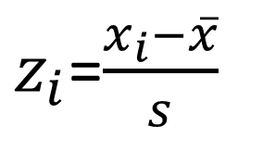
z- score and Empirical Rule
z-Scores
The z-score is often called the standardized value.
It denotes the number of standard deviations a data
value x_{i} is from the mean.
$z_{i}$=$\frac{x_{i}−\overline{x}}{s}$
Excel’s STANDARDIZE function can be used to compute
the z-score.

Slide 32
Z- score and Empirical Rule
z-Scores
An observation’s z-score is a measure of the relative location of the
observation in a data set.
A data value less than the sample mean will have a z-score less than zero.
A data value greater than the sample mean will have a z-score greater
than zero.
A data value equal to the sample mean will have a z-score of zero.

Slide 33
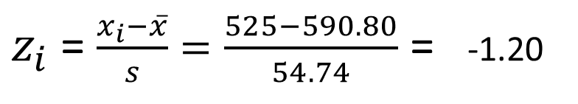
Z- score and Empirical Rule
z-Scores
Example: Apartment Rents
z-Score of Smallest Value (525)
$z_{i}$ = $\frac{x_{i}−\overline{x}}{s}=\frac{525−590.80}{54.74}$ = -1.20
Standardized Values for Apartment Rents
-1.20
-1.11
-1.11
-1.02
-1.02
-1.02
-1.02
-1.02
-0.93
-0.93
-0.93
-0.93
-0.93
-0.84
-0.84
-0.84
-0.84
-0.84
-0.75
-0.75
-0.75
-0.75
-0.75
-0.75
-0.75
-0.56
-0.56
-0.56
-0.47
-0.47
-0.47
-0.38
-0.38
-0.34
-0.29
-0.29
-0.29
-0.20
-0.20
-0.20
-0.20
-0.11
-0.01
-0.01
-0.01
0.17
0.17
0.17
0.17
0.35
0.35
0.44
0.62
0.62
0.62
0.81
1.06
1.08
1.45
1.45
1.54
1.54
1.63
1.81
1.99
1.99
1.99
1.99
2.27
2.27

Slide 34
Z- score and Empirical Rule
Chebyshev’s Theorem
At least (1 - 1/z²) of the items in any data set will be within z standard
deviations of the mean, where z is any value greater than 1.
Chebyshev’s theorem requires z > 1, but z need not be an integer.

Slide 35
Z- score and Empirical Rule
Chebyshev’s Theorem
At least of the data values must be
within of the mean.
75%
z = 2 standard deviations
At least of the data values must be
within of the mean.
89%
z = 3 standard deviations
At least of the data values must be
within of the mean.
94%
z = 4 standard deviations

Slide 36
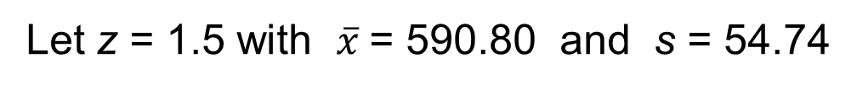
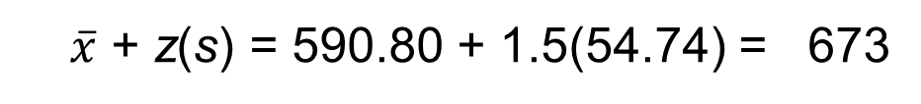
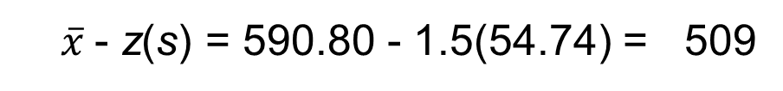
Z- score and Empirical Rule
Chebyshev’s Theorem
Example: Apartment Rents
Let z = 1.5 with $\overline{x}$= 590.80 and s = 54.74
At least (1 - 1/(1.5)²) = 1 - 0.44 = 0.56 or 56%
of the rent values must be between
$\overline{x}$- z(s) = 590.80 - 1.5(54.74) = 509
and
$\overline{x}$ + z(s) = 590.80 + 1.5(54.74) = 673
(Actually, 86% of the rent values are between 509 and 673.)

Slide 37
Z- score and Empirical Rule
Empirical Rule
When the data are believed to approximate a bell-shaped distribution …
The empirical rule can be used to determine the percentage of
data values that must be within a specified number of standard
deviations of the mean.
The empirical rule is based on the normal distribution.

Slide 38
Z- score and Empirical Rule
Empirical Rule
For data having a bell-shaped distribution:
of the values of a normal random variable
are within of its mean.
68.26%
+/- 1 standard deviation
of the values of a normal random variable
are within of its mean.
95.44%
+/- 2 standard deviations
of the values of a normal random variable
are within of its mean.
99.72%
+/- 3 standard deviations

Slide 39
Z- score and Empirical Rule
Empirical Rule
99.72%
95.44%
68.26%
x
μ
μ – 3σ
μ – 1σ
μ + 1σ
μ + 3σ
μ – 2σ
μ + 2σ

Slide 40
Z- score and Empirical Rule
Detecting Outliers
An outlier is an unusually small or unusually large value in a data set.
A data value with a z-score less than -3 or greater than +3 might be
considered an outlier.
It might be:
an incorrectly recorded data value
a data value that was incorrectly included in the data set
a correctly recorded data value that belongs in the data set

Slide 41
Z- score and Empirical Rule
Detecting Outliers
Example: Apartment Rents
The most extreme z-scores are -1.20 and 2.27
Using |z| > 3 as the criterion for an outlier, there are no outliers in this data set.
Standardized Values for Apartment Rents

Slide 42
Use of EXCEL for Measures of Central Tendency

Slide 43
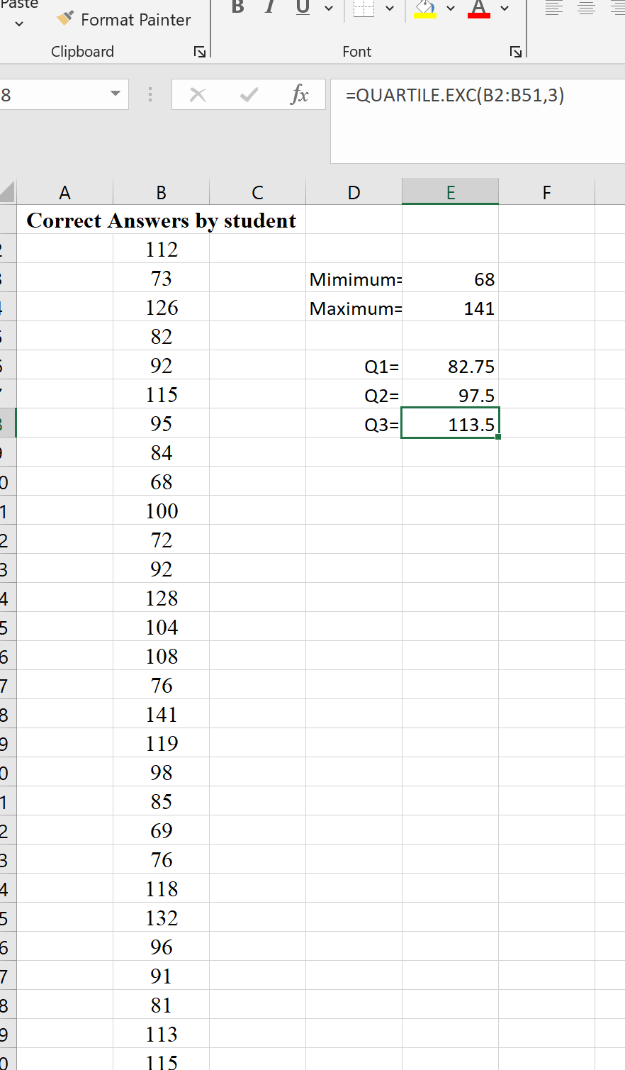
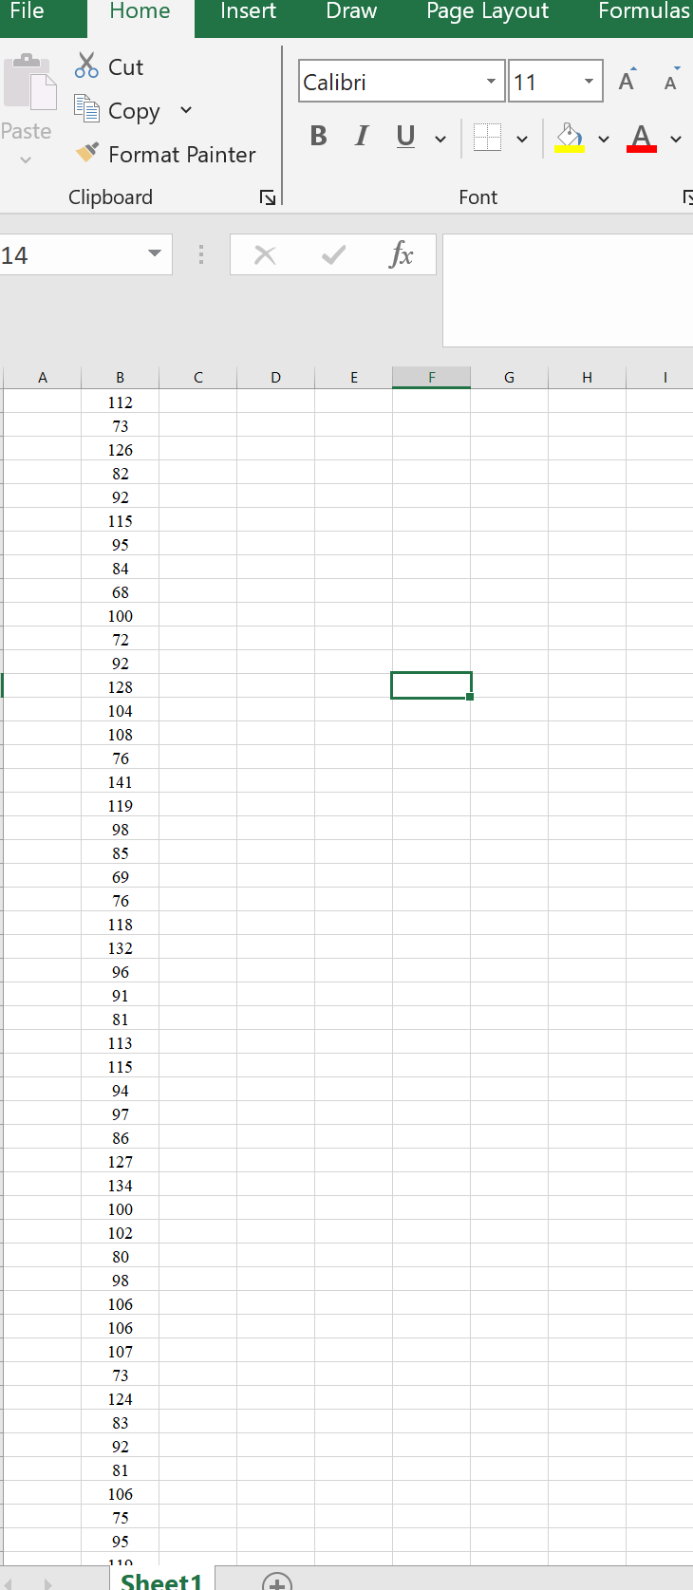
Excel for Box Plot
Number of Correct answers by 50 students
STEP-1 Find the minimum and maximum value
Find the quartiles by using Q1 as =quartile.exc(Range of the data,1), Q2 as =quartile.excl(Range of the data,2)or by taking average of data and Q3 as =quartile.exc(Range of the data,3)
Data of correct answers by 50 students
Harpreet Kaur

Slide 44
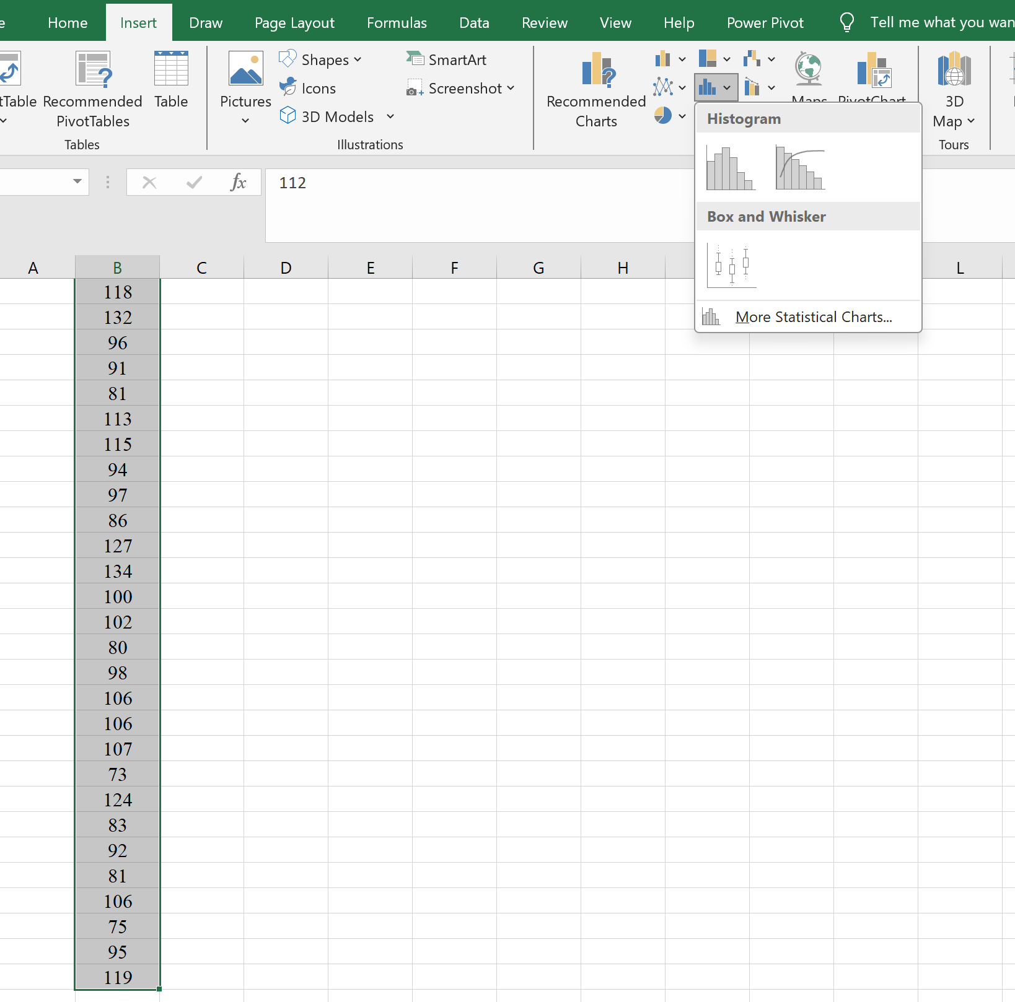
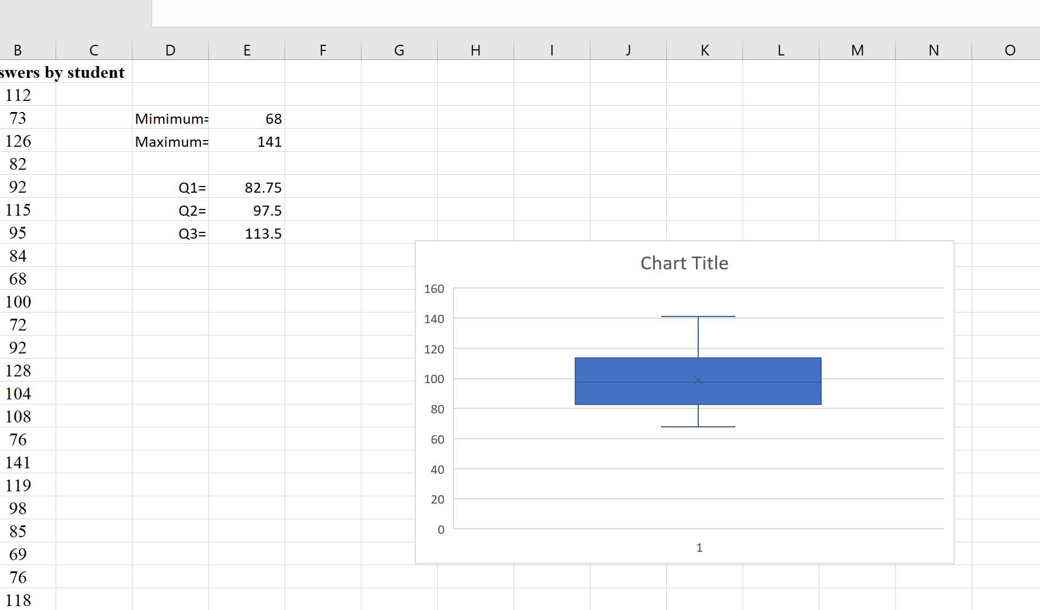
Excel for box plot
STEP-2 Select the data, insert and click on histogram to get the access for Box plot
STEP-3 Click on the box plot to create the plot for data
Harpreet Kaur

Slide 45
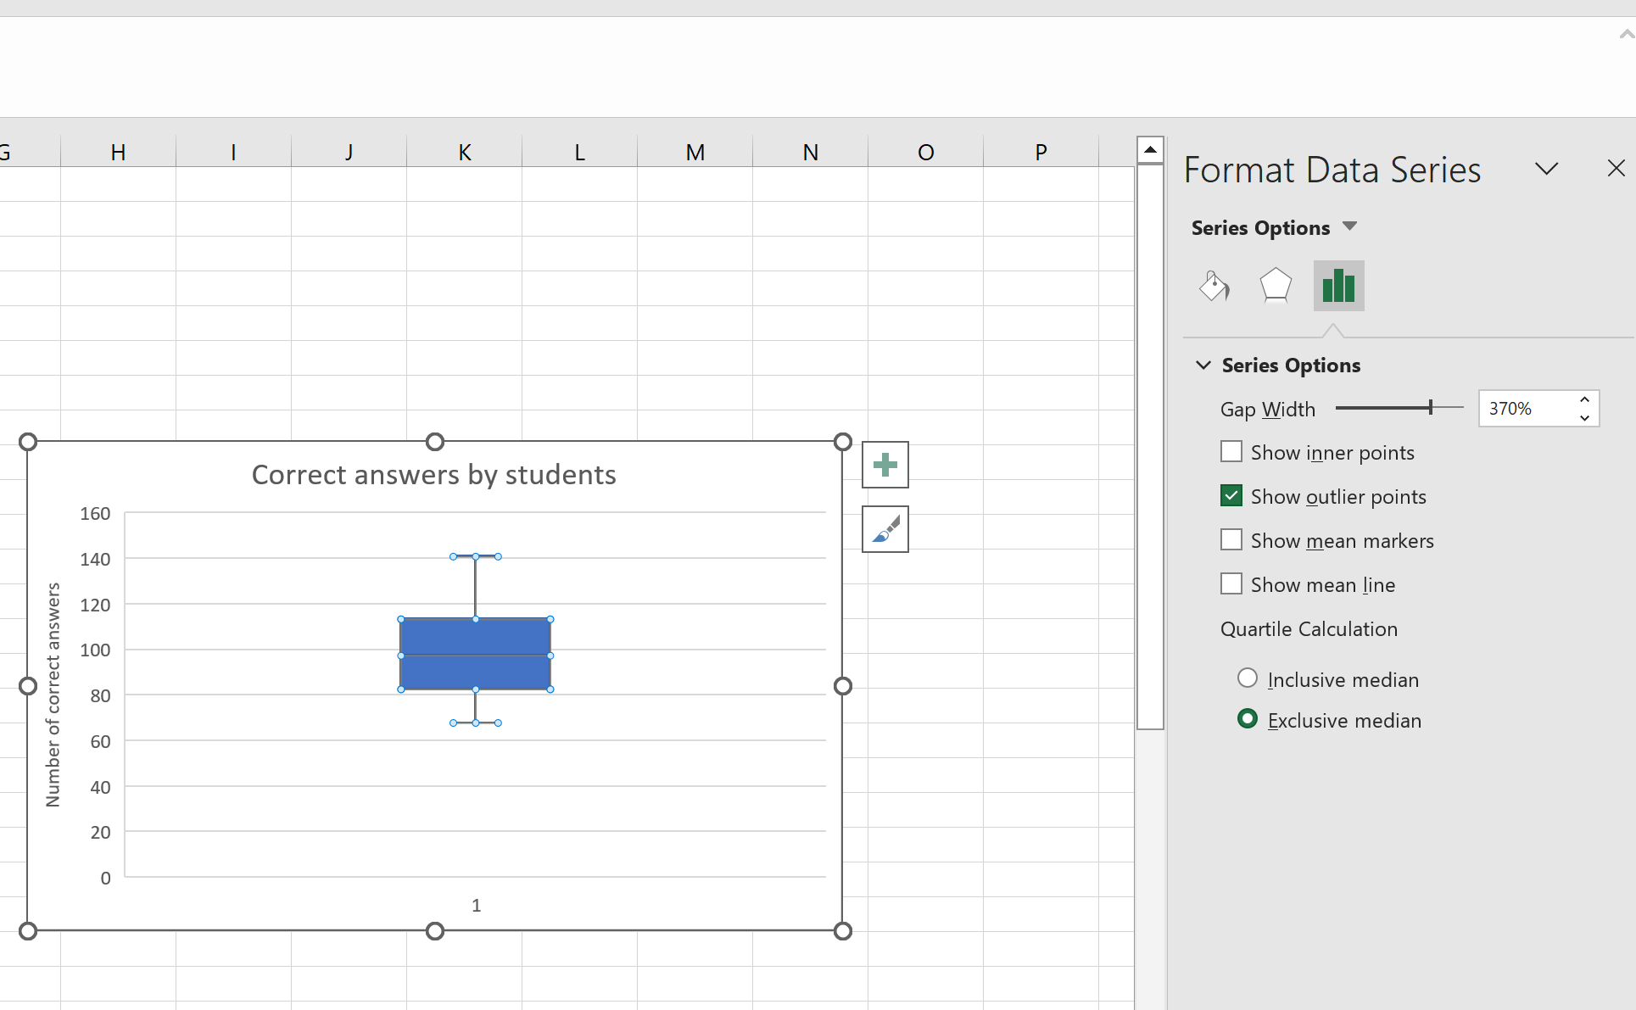
Excel for box plot
STEP-4 Change the axis both vertical and top axis. Select the box plot by right click on it choose format data series remove the mean marker and change the gap width. Box Plot is Ready.
Harpreet Kaur

Slide 46
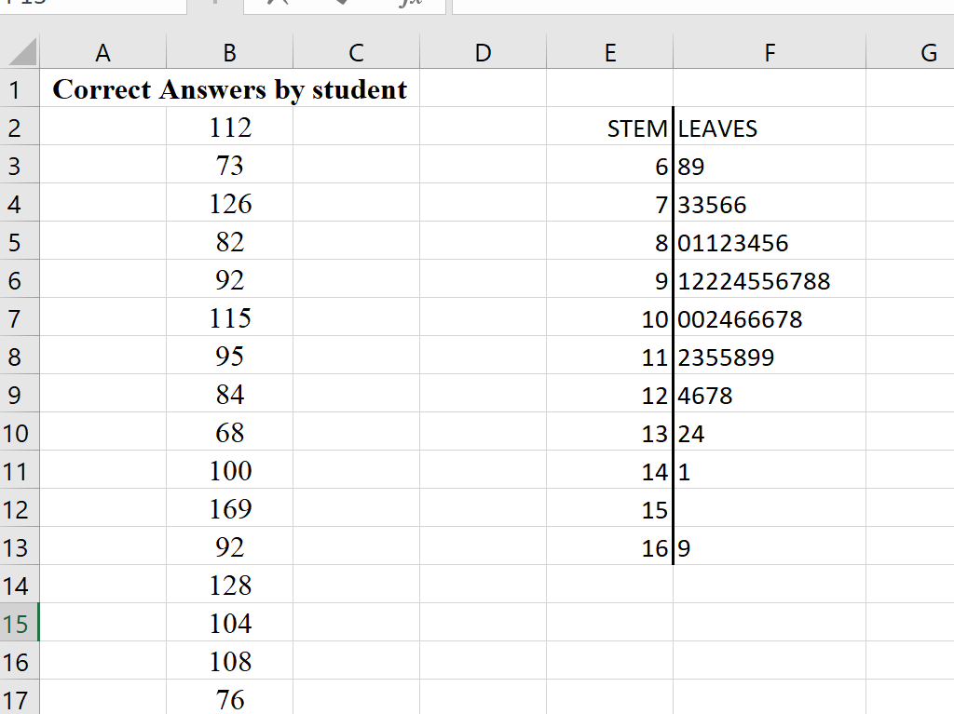
Excel for stem and leaf
Stem and leaf for data of 50 students for correct answers
Harpreet Kaur

Slide 47
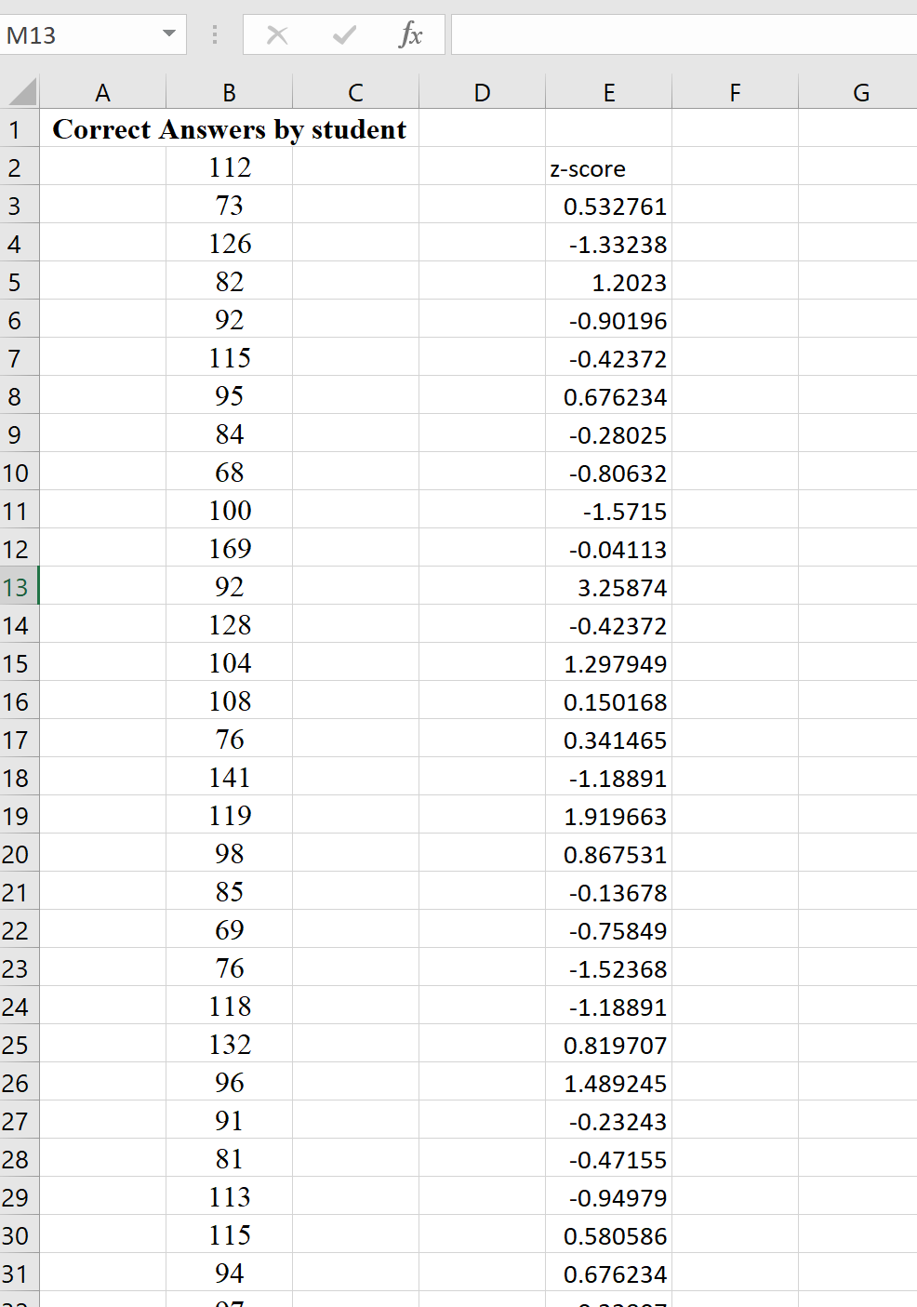
Excel for z-score value
Z-score values for data of 50 students for correct answers
Harpreet Kaur

Slide 48
R-Studio

Slide 49
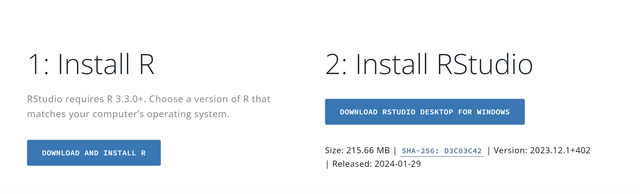
R-STUDIO
Installing R and RStudio
https://posit.co/download/rstudio-desktop/

Slide 50
R-STUDIO
Understanding the difference between R and RStudio is crucial for those venturing into the world of data analysis and programming.
While R is a programming language specifically designed for statistical computing and graphics, It is widely used for statistical analysis. RStudio serves as an integrated development environment (IDE) that enhances the functionality and workflow of working with R.

Slide 51
R-STUDIO
Interface Tour
Once you have R and RStudio installed, let’s take a quick tour of the interface. The RStudio interface consists of several components:
Source Editor: This is where you write your R code. It provides features like syntax highlighting, code completion, and line numbering to enhance your coding experience.
Console: The console is an interactive environment where you can execute R code and see the results immediately.
Environment and History: The environment pane displays objects in your workspace, while the history pane shows your previous commands.
Plots and Files: These panes allow you to view and manage plots and files respectively.
Understanding the layout and functionality of these components will help you navigate RStudio more efficiently.

Slide 52
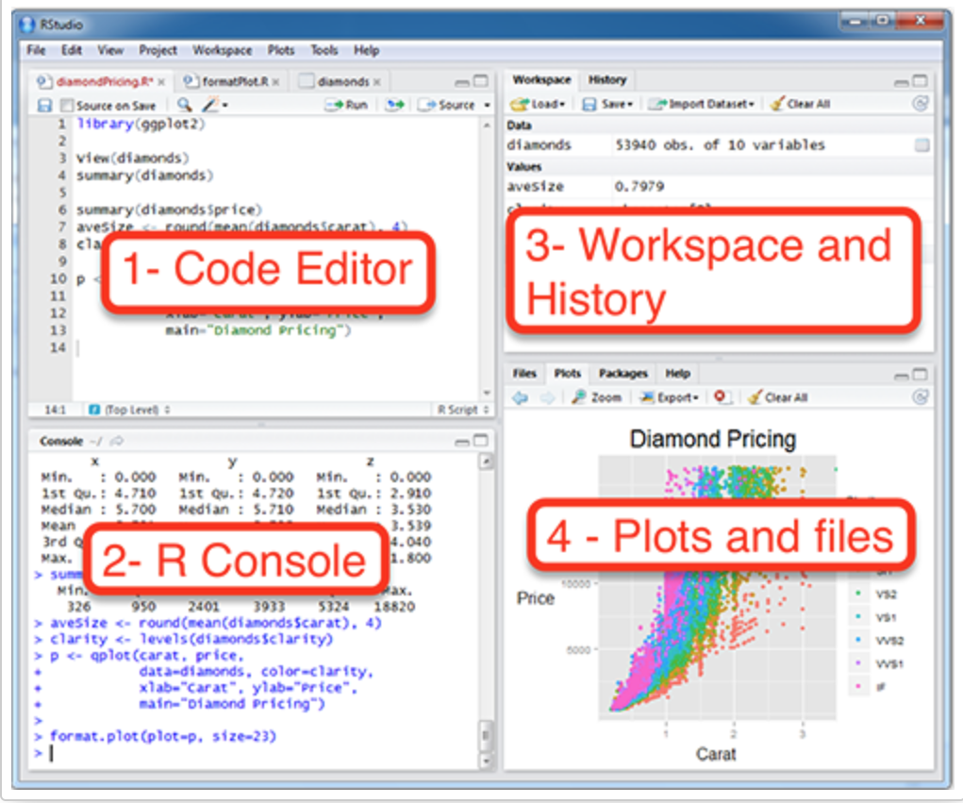
R-STUDIO SCREEN

Slide 53
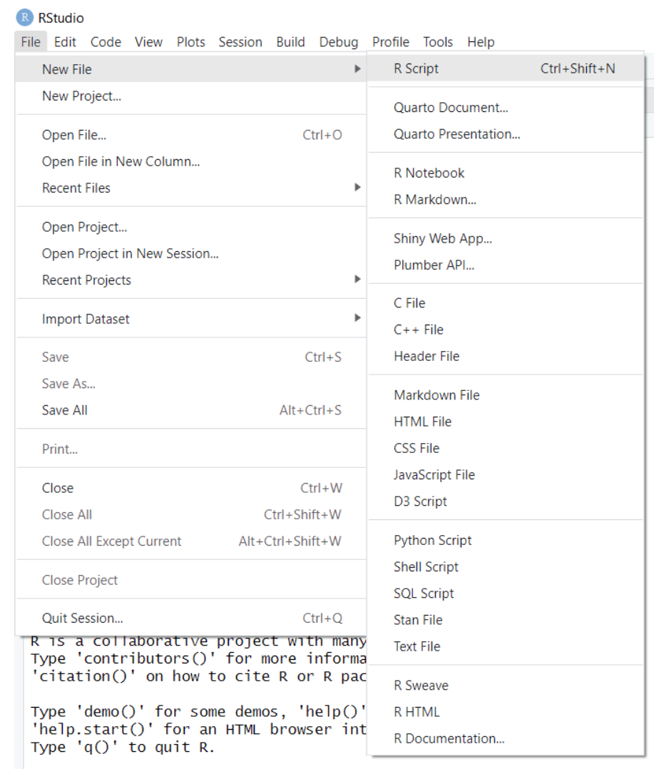
R-STUDIO
Creating a New R Script
To create a new R script, go to “File” > “New File” > “R Script.” Alternatively, you can use the keyboard shortcut Ctrl+Shift+N (Windows/Linux) or Command+Shift+N (Mac). This will open a new source editor window where you can start writing your code.

Slide 54
R-STUDIO
Managing the Workspace
A. Understanding the Environment Pane
The environment pane in RStudio provides a snapshot of the objects in your current workspace. It displays variables, data frames, functions, and other objects that you create or load during your R session. Understanding how to view and manipulate objects in the environment pane is crucial for data analysis.
B. Importing and Exporting Data
Working with data is a common task in RStudio. You can import data from various file formats such as CSV, Excel, or databases using functions like read.csv() or read.xlsx(). Similarly, you can export data frames or plots to external files using functions like write.csv() or ggsave(). Mastering these data import and export techniques will boost your productivity.

Slide 55
R-STUDIO
Managing the Workspace
C. Viewing and Modifying Data Objects
RStudio provides several ways to view and modify data objects. You can preview data frames by clicking on them in the environment pane or use functions like head(), tail(), or View() to get a glimpse of your data. Manipulating data objects by adding or removing columns, filtering rows, or transforming variables is crucial for data analysis, and RStudio offers various functions and packages for these operations.
D. Clearing the Workspace
As you work on multiple projects or datasets, your workspace can become cluttered with unnecessary objects. RStudio allows you to remove objects from your workspace using the “Remove” button in the environment pane or the rm() function. Clearing the workspace helps you manage memory efficiently and prevents confusion caused by redundant objects.

Slide 56
R-STUDIO
Using the Console
The console in RStudio serves as an interactive environment for executing R code on the fly.
A. Introduction to the R Console
The console is the primary interface for interacting with R. It allows you to execute code line by line, receive immediate results, and experiment with R functions and packages.
B. Running Code Directly in the Console
To execute code in the console, simply type or paste your R code and press Enter. The console will immediately execute the code and display the results. This interactive feedback loop is especially useful when exploring data or testing small code snippets.

Slide 57
R-STUDIO
C. Accessing Command History
RStudio keeps a history of your previous commands in the history pane. You can access this history by using the Up and Down arrow keys or the Ctrl+Up (Windows/Linux) or Command+Up (Mac) shortcut. Navigating your command history allows you to reuse or modify previous commands quickly.
D. Utilizing Code Completion and Syntax Highlighting
RStudio provides code completion and syntax highlighting to enhance your coding experience. When typing R code, RStudio suggests functions, variable names, and arguments, saving you time and reducing the chances of typos. Syntax highlighting helps differentiate between different elements of the code, making it easier to read and understand.

Slide 58
R-STUDIO
Managing Packages
R packages extend the functionality of R, providing additional functions and tools for data analysis and visualization. Here are some tips for managing packages in RStudio:
Installing and Loading Packages
To install a package, use the install.packages() function. Think of this as buying a recipe book from the store, bringing it home, and putting it on your shelf.
install.packages("ggplot2")

Slide 59
R-STUDIO
R comes with a number of built-in functions and datasets, but one of the main strengths of R as an open-source project is its package system. Packages add additional functions and data. Frequently if you want to do something in R, and it is not available by default, there is a good chance that there is a package that will fulfill your needs.
Once a package is installed, it must be loaded into your current R session before being used. Think of this as taking the book off of the shelf and opening it up to read.
library(ggplot2)
Once you close R, all the packages are closed and put back on the imaginary shelf. The next time you open R, you do not have to install the package again, but you do have to load any packages you intend to use by invoking library().

Slide 60
SUMMARY
Week | Topic
Week 3 | Percentiles Quartiles Five-Number Summary Distribution Shape z-Scores Chebyshev’s Theorem Empirical Rule Detecting Outliers Use of Excel to create box plot, z-score R- Studio Software introduction

Slide 61

Any Questions

Slide 62
NEXT
Week # | Topic /Theme/Chapter | Assessments and Activities | Learning Objectives
Week 4 | Review | Test-1 Based on week-1,2 and 3 contents

